Slide 1
DITA Topic Basics

Slide 2
Session overview
DITA Key Concepts
Topic Overview
Topic Types
Common DITA Concept Elements
Concept Guidelines
Common DITA Task Elements
Common DITA Task Guidelines
Common DITA Reference Elements
Common DITA Reference Guidelines

Slide 3
DITA topic information
Reference for all sessions:
DITA Best Practices
A Roadmap for Writing, Editing, and Architecting in DITA
Laura Bellamy, Michelle Carey, and Jenifer Schlotfeldt
Copyright 2012

Slide 4
Topic types
Topics
Author content in topics
Generic Topic
Three additional topic types based on the Generic Topic – Concept, Task, and Reference
Each topic consists of tags
DITA maps (think table of contents)
DITA map
Book map

Slide 5
Topics
Topics = Building blocks
Make sense on their own
Can be assembled different ways
In writing content, avoid transitions at beginning or end (“As you’ve just seen,” etc.)
Do We Really Need All that Glue?
JoAnn Hackos on transitional text in topics
http://dita.xml.org/node/1410

Slide 6
Topic types
Concept
Describes something.
Task
Tells how to do something. Usually includes numbered steps.
Reference
Gives details of interest, often in look-up lists or tables.

Slide 7
Pop quiz
Let’s test this topic thing out.
Scenario: You’re tasked with writing content for a new software user guide and a corresponding training course.
Directions:
Take the scenario.
You decide what type of topic you need to create.
Then you will see the answer.

Slide 8
Pop quiz scenarios
You are going to write the customer service information and put it in the guide.
You have a system architecture graphic to describe
You have a complex form and you want to provide all the field names and definitions
You want to tell customers how to log on to the software
You need to add the copyright information
You want to tell customers the way to configure their system options
You want to provide details around a specific feature of the software
You have a process that you want customers to understand

Slide 9
Pop quiz answers
Concept - You are going to write the customer service information and put it in the guide.
Concept - You have a system architecture graphic to describe
Reference - You have a complex form and you want to provide all the field names and definitions
Task- You want to tell customers how to log on to the software
Concept - You need to add the copyright information
Task - You want to tell customers the way to configure their system options
Concept - You want to provide details around a specific feature of the software
Task - You have a process that you want customers to understand

Slide 10
Common DITA Concept elements
DITA Element | Description
<title> | Provides the topic title
<shortdesc> | Introduces the concept
<conbody> | Contains the body of the topic
<section> | Organizes content in a topic into sections
<sl> | Displays a list of short or simple items
<ul> | Displays a content as an unordered bulleted list
<dl> | Displays a list of terms or short concepts and their definitions
<fig> or <image> | Provides a figure and caption so that you can insert graphics
<term> | Highlights new terms

Slide 11
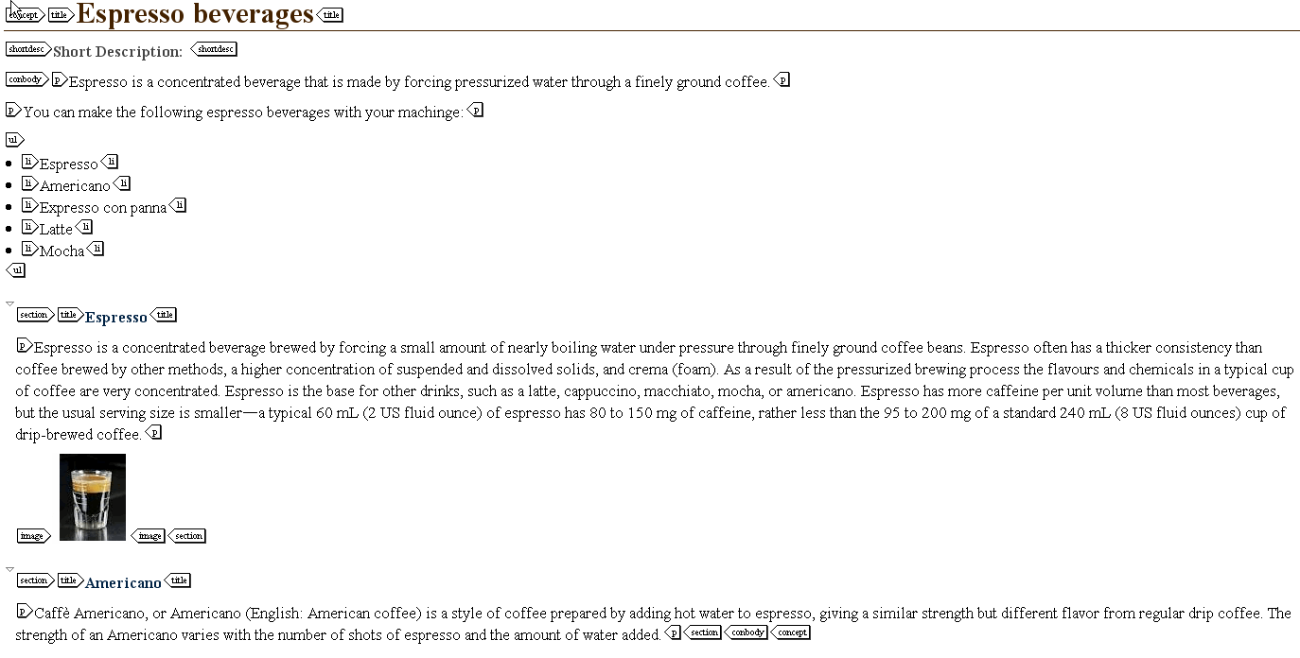
Common DITA Elements – In Context

Slide 12
Concepts guidelines
Describe one concept per topic
Use concept topics appropriately
Use noun-based phrases for titles
Create effective concept topic short descriptions
Organize the concept and break up dense text
Add images to describe the concept
Use <term> element correctly (used for terms the first time you describe them)

Slide 13
Common DITA task elements
DITA Element | Description
<title> | Provides the topic title
<shortdesc> | Introduces the task
<steps> | Contains ordered steps for the entire procedure
<steps-unordered> | Contains unordered steps for the entire procedure
<context> | Background information for users to understand task
<steps>,<step>, and <cmd> | Contains the steps for the task
<substeps>, <substep>, and <cmd> | Contains the substep for the step
<info> | Provides information users need to complete the step
<stepresult> | What happens when step is completed
<stepxmp> | An example of what happens when step is completed
<choices> and <choice> | Displays choices in a bulleted list
<choicetable> | Displays choices in a 2-column table. Describe steps for each choice
<postreq> | Info about what must be done after task is completed
<example> | Example that tells or supports the task
<result> | Expected outcome when task is done

Slide 14
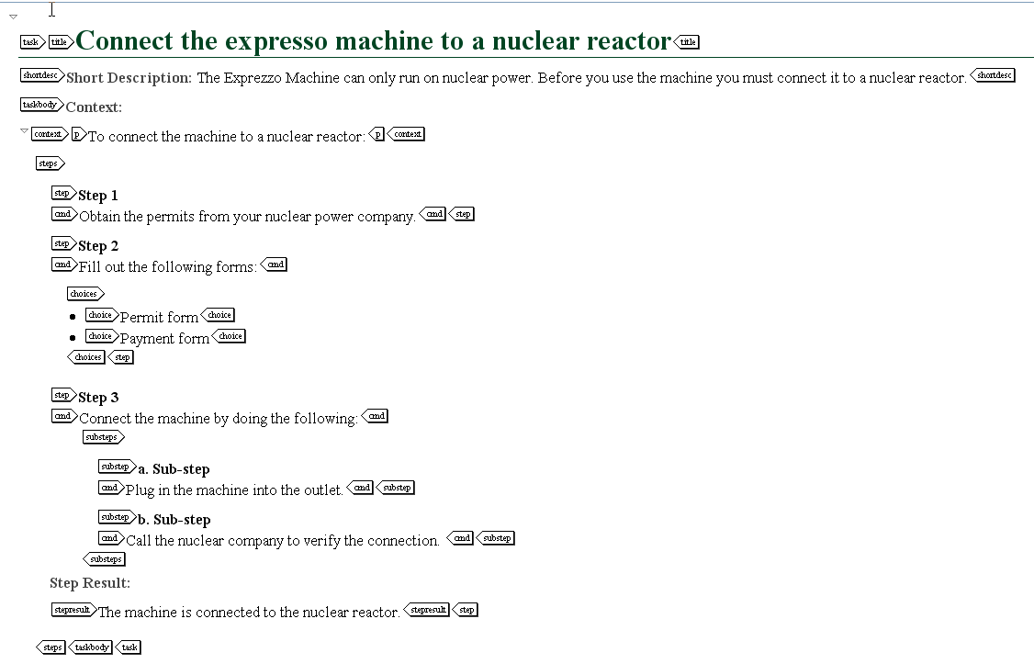
Common Task Elements – In Context

Slide 15
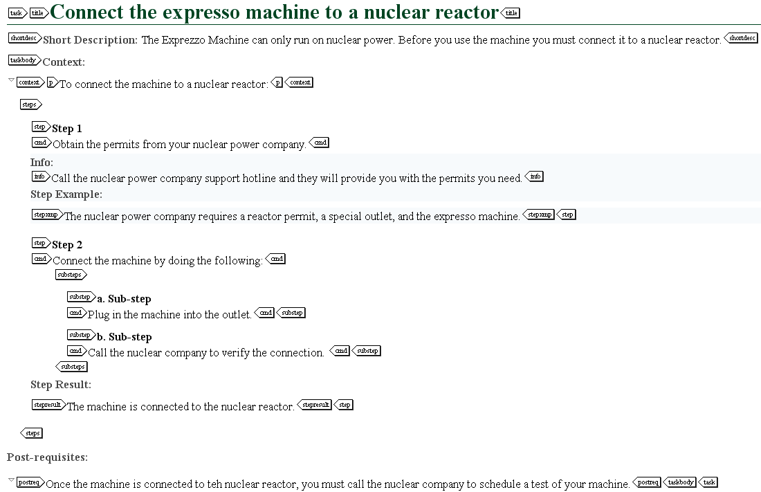

Slide 16
Task high-level best practices
Include only one procedure per task topic
Use verb-based or “how to” phrases for task titles
Create effective task topic short descriptions
Ensure every step has an imperative verb
Write 10 steps or fewer per task topic
More than 10 break into separate tasks – nest in the Ditamap
Combine short steps
Don’t nest any more than one level of substeps
Use <choice> and <choicetable> correctly
Use the <info>, <stepxmp>, and <stepresult> elements correctly
At the end of the task, add an example, postrequisites, and results as needed

Slide 17
Common DITA Reference elements
DITA Element | Description
<title> | Provides the topic title
<shortdesc> | Introduces the reference
<refbody> | Contains the body of the topic
<section> | Organizes content in a topic into sections
<table> | Contains table content
<ul> | Displays a content as an unordered bulleted list
<dl> | Displays a list of terms or phrases and their definitions
<example> | Contains example content that explains or supports the topics
<parml> | Displays parameters in a format similar to a definition list
<properties> | Lists properties in a table by type, value, and description
<simpletable> | Provides a table that doesn’t require a title
<refsyn> | Contains a syntax diagram

Slide 18
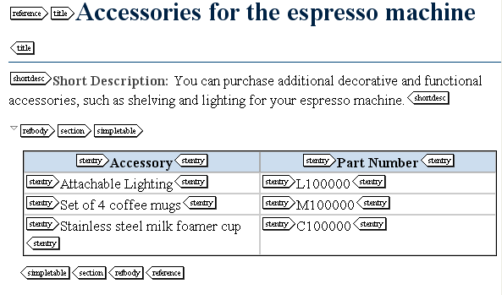

Slide 19
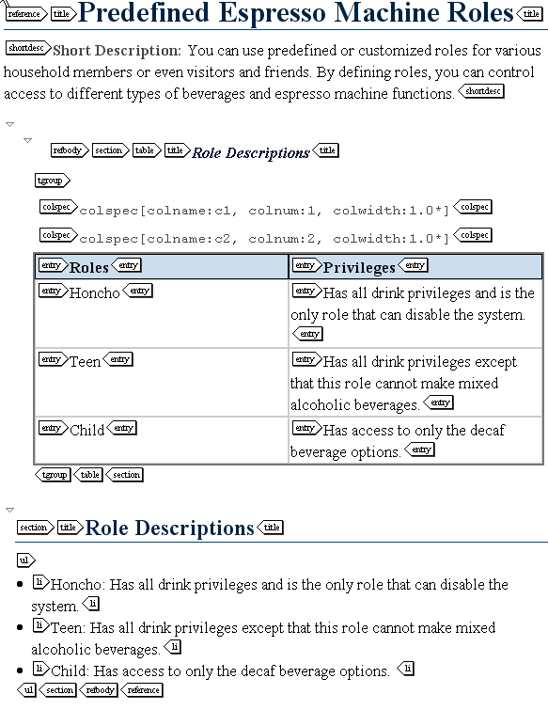

Slide 20
Reference guidelines
Use noun-based phrases in titles
Create effective reference topic short descriptions
Describe one type of reference information per topic
Use sections to organize the reference information
Use the correct type of table (table and simple table)
Simple table – Short tables that do not require titles
Table – Tables that require a title
The <properties> element for tables that describe types, values, and descriptions for each item

Slide 21
Session Results
DITA Key Concepts
Topic Overview
Topic Types
Common DITA Concept Elements
Concept Guidelines
Common DITA Task Elements
Common DITA Task Guidelines
Common DITA Reference Elements
Common DITA Reference Guidelines

